Slide 1
Analysis on Major Air Pollutants in Urban Areas
Name: Saikiran Jelloji
Student ID: M00341403
Class Code: CIS663-01-SP23
Class Name: R Studio
Semester/Year 2023

Slide 2
Overview of the Project
The project has included more of visualization to understand the distribution of main air pollutants, Nitrogen, Sulphur, and Carbon, in urban areas.
The project is conducted in R-Studio using Markdown.
The project has utilized an already existing data obtained from the data.world website.
The project has included a multiple linear regression model for predictive analysis.
The model can be used for predicting the occurrence of air pollution from the main air pollutants like the Nitrogen, Sulphur, and Carbon.
It also considered probability of having respiratory diseases as result of air pollution from effect of Sulphur, Carbon, and Nitrogen.
The project has identified that Sulphur is the leading air pollutant in the urban areas.

Slide 3
Introduction
Air pollution has become a serious challenge in urban areas.
Air pollution is associated with diverse health issues like cancer, a deadly disease, or heart disease, generally identified as respiratory diseases.
Therefore, my project tries to identify the factors that are highly causing air pollution in urban areas and take the right actions.
The importance of this project is:
It will provide the advantage of identifying the main causes of air pollution and also forecast the levels of air pollution in urban areas.
It will be helpful to create awareness among people on taking precautions that would be vital to avoid being exposed to air pollutants.
It will help environmental regulatory boards in implementing regulations that might help reduce air pollution in urban areas.

Slide 4
Literature Review
There have been research papers that have shown interest in the predictions of the levels of air pollution by the use of techniques associated with statistical models.
The research paper by Mustafaraj et al. (2011) has implemented a technique that used both auto regressive and neural network models to predict air pollution levels.
Another study by Qin & Gong (2022) incorporated the use of machine learning methods for the predictions of Carbon dioxide levels in China.
In this project, we need to identify how well can the linear regression model be implemented in predicting the probability of having respiratory diseases from different levels of Nitrogen, Sulphur, and Carbon air pollutants in urban areas.

Slide 5
Data
The data used in the project has been obtained from data.world website.
The website stores data associated with environmental factors.
The data contains the Sulphur, Nitrogen and Carbon dioxide levels variables that are measured in the air and information on the temperature, humidity, or wind speed.
The data is loaded into R using read.csv().
The data is made up of mean values for the Sulphur, Nitrogen and Carbon dioxide air pollutants for different cities and countries.

Slide 6
Methodology
For better analysis outcomes, the main variables for use in the project were preprocessed.
First, the checking of missing values in dataset variables was done.
Next, the NO2.Mean, SO2.Mean, and CO.Mean variables were converted to numeric.
Visualizations on distribution of each of the three air pollutants were performed by use of histograms.
Next, distribution of each of the three pollutants in different cities was visualized by use of the barcharts.

Slide 7
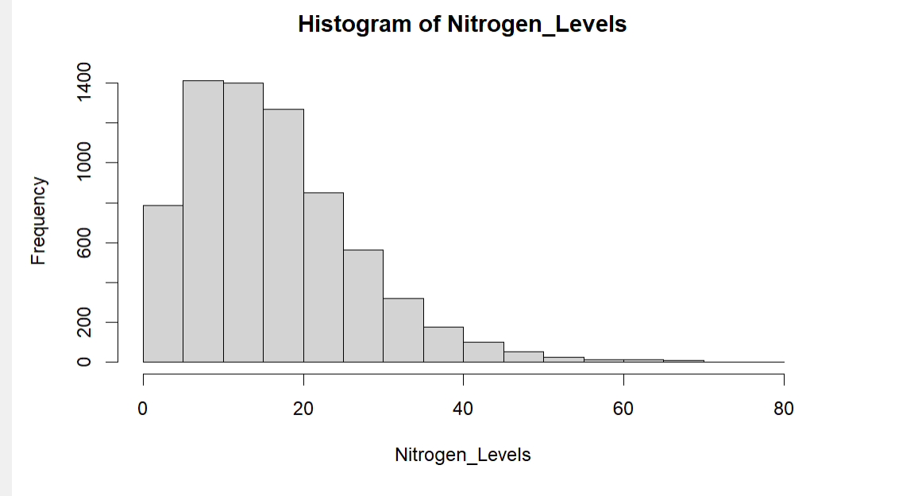
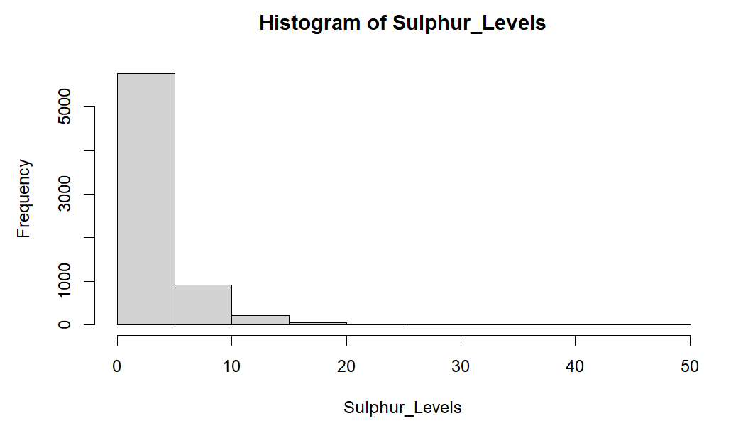
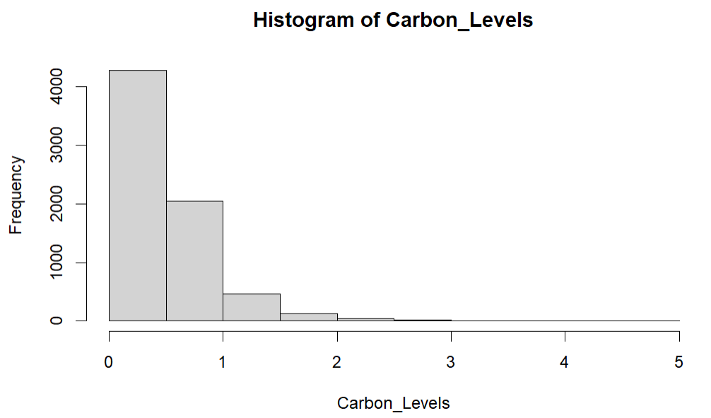
Results
The results of the visualizations on Nitrogen show that the highest frequency is at 1400, Sulphur is at above 5000, and Carbon is at 4000.

Slide 8
Methodology Contd.
Next, data was split to have training data set and testing data set in the ratio of 80% and 20% respectively.
The multiple linear regression model was then fit by use of the lm() function.
Respiratory.Diseases variable was used as the dependent variable while SO2.Mean, CO.Mean, and NO2.Mean were used as the independent variables.

Slide 9
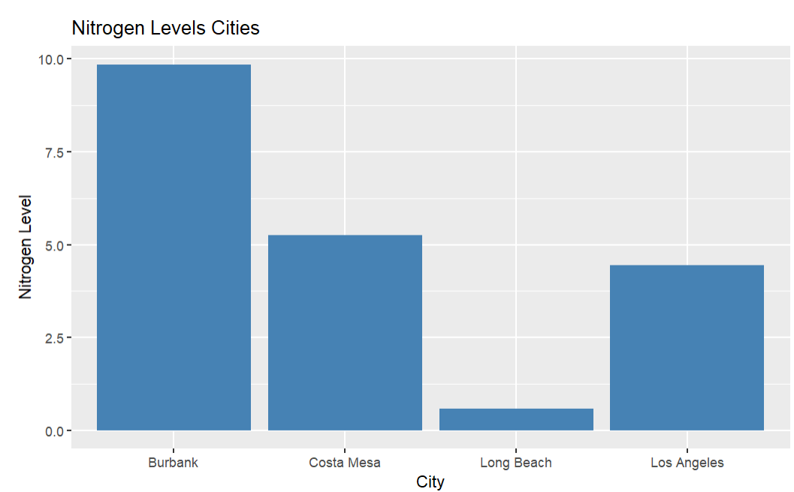
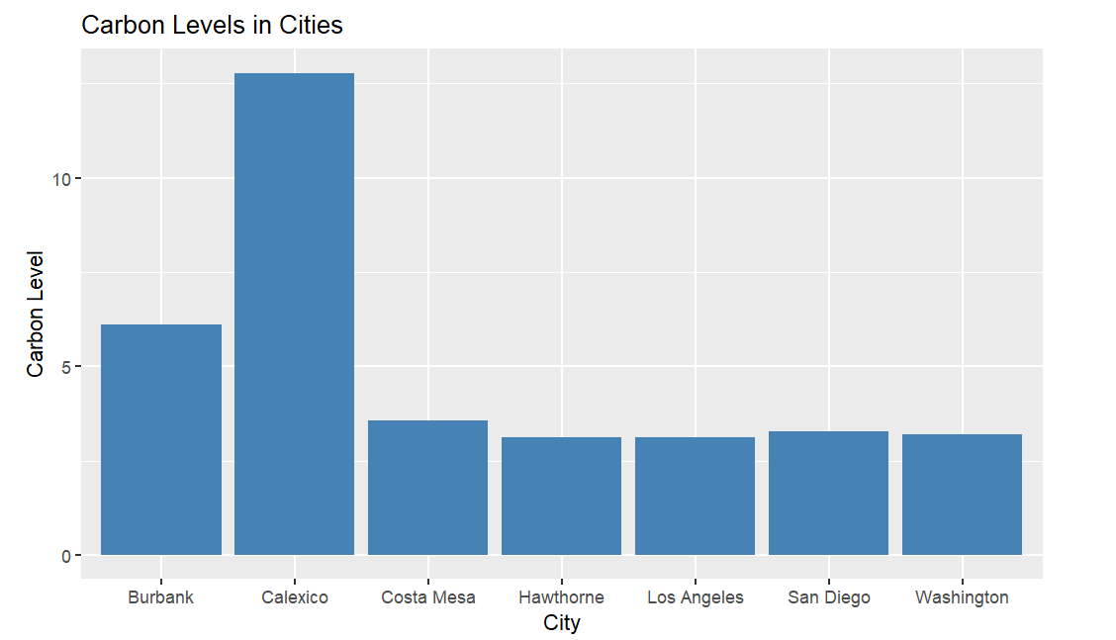
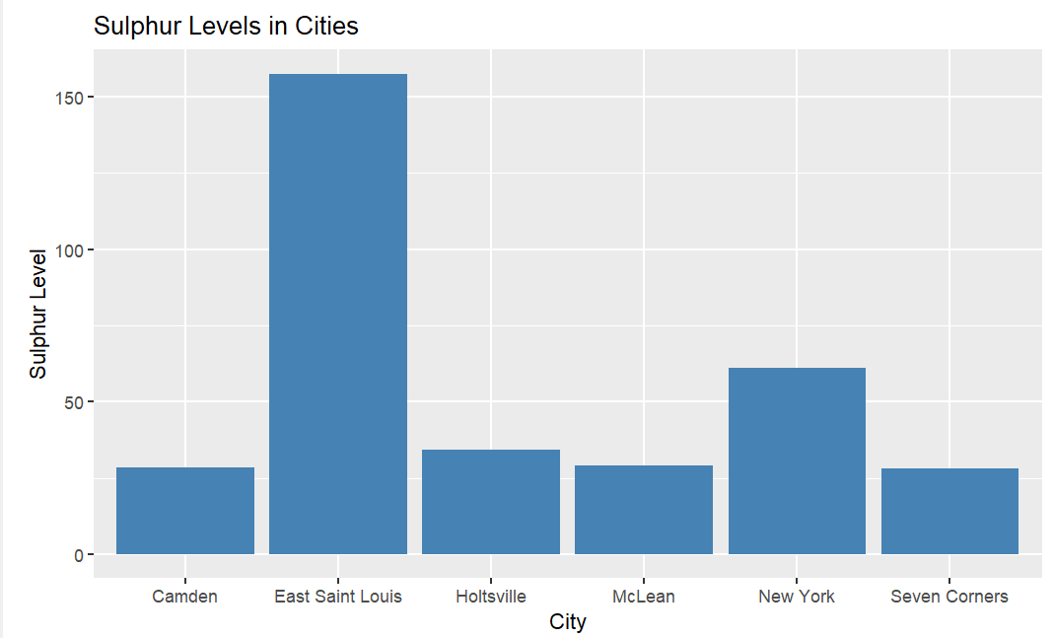
Results Contd.
The bar charts for Nitrogen, Sulphur, and Carbon in different cities show that Sulphur affect East Saint Louis city the most, Nitrogen affects Burbank the most, and Carbon affects Calexico city the most.

Slide 10
Results Contd.
The results of the linear regression model show that the equation for use for predicting having a respiratory disease is:
Predicted_outcome= 0.0868051+0.0006991*SO2.Mean- 0.0154271*CO.Mean+0.0007094*NO2.Mean.

Slide 11
Implications
It would be recommended from this project that several machine learning techniques be implemented for the prediction analysis.
In addition, a more defined data be used to ensure that the results of the project can be generalized for other cities and areas.

Slide 12
Conclusion
The project has been successfully performed and it has been clear on the main air pollutants in urban areas and in different cities.
Sulphur is main air pollutant in urban areas.
Also the linear regression model have shown that the predictor variables are not statistically significant to our model (Maverick, 2023).

Slide 13
References
Maverick. (2023). Learn to Predict Using Linear Regression in R With Ease (Updated 2023). Analytics Vidhya. https://www.analyticsvidhya.com/blog/2020/12/predicting-using-linear-regression-in-r/
Mustafaraj, G., Lowry, G., & Chen, J. (2011). Prediction of room temperature and relative humidity by autoregressive linear and nonlinear neural network models for an open office. Energy and Buildings, 43(6), 1452-1460.
Qin, J., & Gong, N. (2022). The estimation of the carbon dioxide emission and driving factors in China based on machine learning methods. Sustainable Production and Consumption, 33, 218-229.

